Slide 1

Philosophy Study Away Experiences
Chicago, Abroad, and Baca

Slide 2
Philosophy on the move
Most modern philosophers have studied and reflected on the basic questions of life in seminar rooms and office chairs. But philosophy began in the streets, with Socrates questioning his peers. The dramatic philosophies of life – whether of the Buddha, medieval monks, Thoreau, indigenous environmentalists, Marx, utilitarians, or others – arose in and engaging with everyday life. Philosophy at Colorado College seeks to reach out from and to bring existence into our seminars, which sometimes means traveling away from our comfortable Colorado Springs campus.
What follows are some of experiences we engage in with students, past, present, and future.

Slide 3

Psychoanalysis in Chicago
Professors John Riker & Marcia Dobson
Taught at the Chicago Psychoanalytic Institute

Slide 4
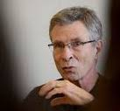
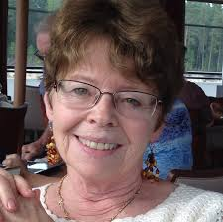
PH263: Contemporary Psychoanalysis – Theory and Practice
We believe that psychoanalysis, from Freud’s theory to that of contemporary self psychology and relational theory, offers human beings the most profound way of probing the human psyche in general and individual souls in particular that has ever been conceived. To explore the ideas and transforming practices of psychoanalysis, we offer PH 263: Contemporary Psychoanalysis Theory and Practice at the Chicago Psychoanalytic Institute, located in downtown Chicago, next to the Art Institute, and surrounded by Chicago’s world-famous architecture. In this course students will get an introduction to the work of Freud and Kohut and read the works of and meet with distinguished Chicago psychoanalysts, who will present new approaches to understanding psychoanalytic theory and therapeutic action. Some will present case studies in which we see a psychoanalytic approach to the human soul at work. We will also explore how psychoanalysis can be used in the interpretation of culture, especially art and theater.
Not only do students learn about psychoanalysis in this courses, but they get to live in the heart of downtown Chicago, one of the most vibrant, beautiful cities in the world. Beaches, really cool restaurants, fabulous architecture and art, peoples from all over the globe, concerts, drama—it’s all there and within walking distance!
Offered most years in the spring.

Slide 5
Previous student comments:
“This course was utterly life-changing.”
“The best course I have ever had at CC—nothing else even comes close.”
“The analysts were unbelievable; I have never encountered anyone like them.”

Slide 6
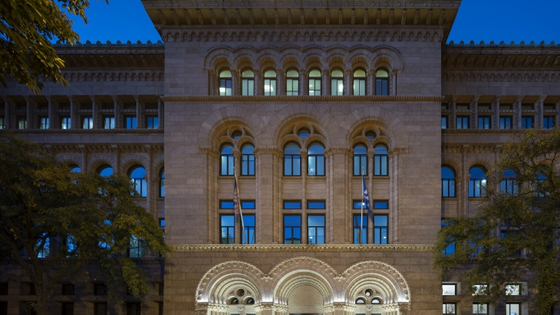

Pragmatism in Chicago
Professor Dennis McEnnerney
Taught at the Newberry Library

Slide 7
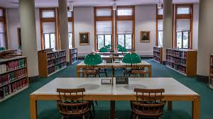
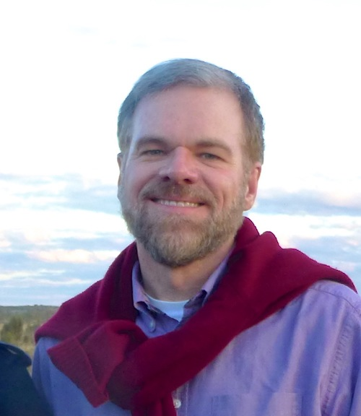
PH303: PRAGMATISM, PROGRESSIVISM, FEMINISM
Birth of an American Century
Offered in 2012 and 2014.
This course investigated influential early twentieth-century responses to the polarization of America by class, religion, ethnicity, race, and sex. Pragmatist philosophers challenged people to rethink the human mind, encouraging Americans to become confident about their abilities to respond to and manage change. Early progressive movements, meanwhile, organized cultural elites and common people, sometimes including poor urban ethnic minorities, claiming to constrain the power of corporations, reject prejudices, and democratize society and politics – though whether progressive politics was actually democratic or anti-democratic remains in dispute. Both developments drew women into leadership roles in areas that had traditionally been patriarchal and male-dominated, driving men and women alike to begin rethinking sex roles and gender identities, with the resulting women’s rights campaigns feeding back on the era’s re- conceptualization of the mind and social organization. Together these three interrelated movements helped transform the relatively closed Protestant, business-dominated, patriarchal order of the late nineteenth century, giving birth to an America that aspired to embrace diversity, social and political inclusion, and sexual equality.
After a brief introduction to these intellectual and historical movements, students used the rich holdings of the Newberry Library to develop research projects that assessed these movements, their interactions, and their legacies. Students lodged at the Canterbury Court Apartments in the Gold Coast neighborhood, just blocks from the Newberry Library.

Slide 8
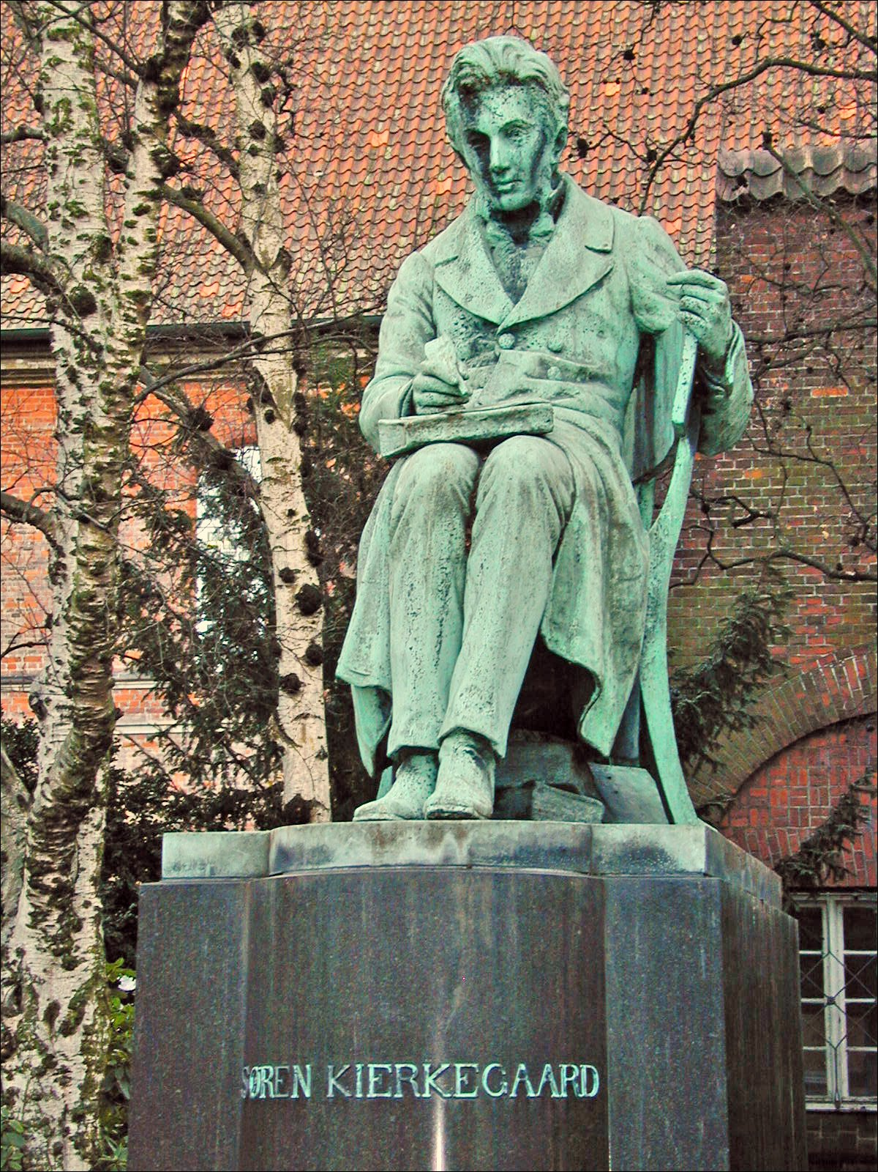
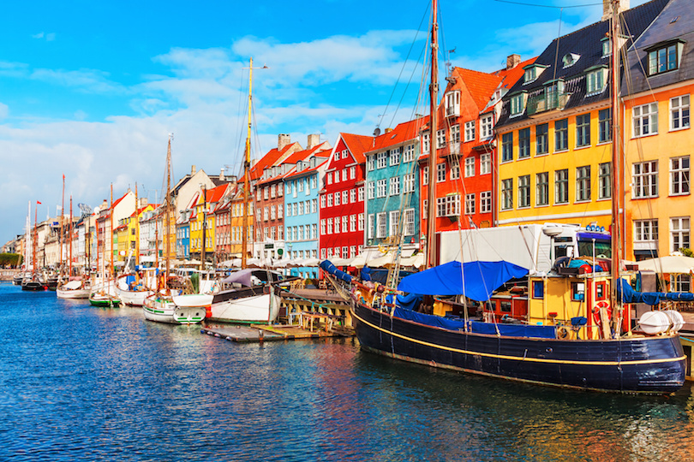
Existentialism in Denmark
Professor Rick Furtak
Taught in Copenhagen and beyond

Slide 9
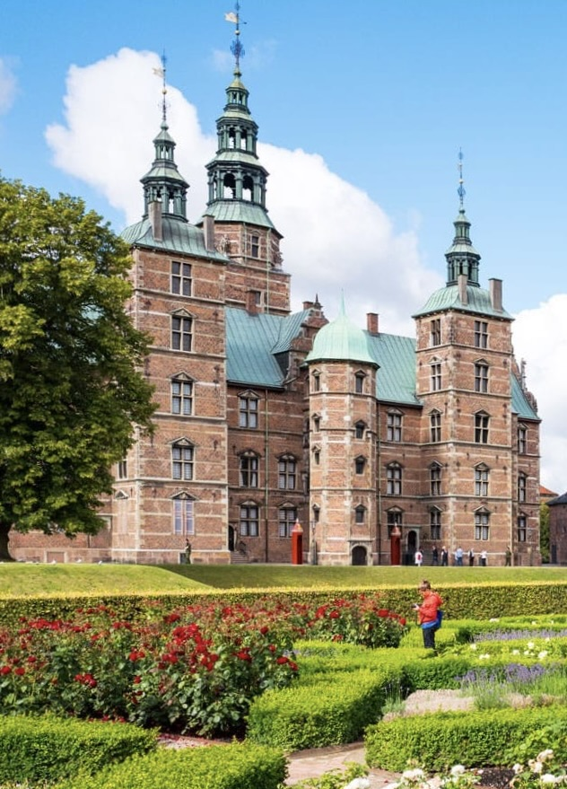
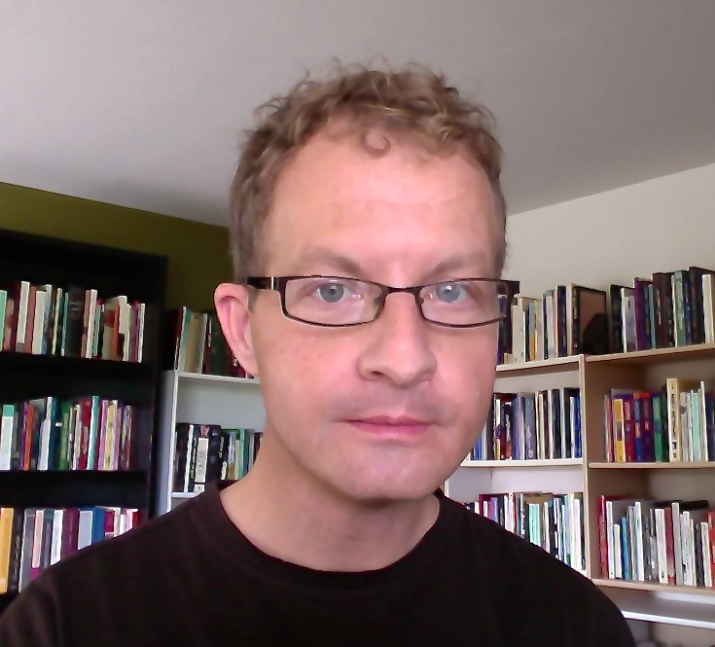
PH203: Kierkegaard in Copenhagen –
The Birth(place) of Existential Philosophy
Søren Kierkegaard (1813-1855), widely acknowledged to be the founding father of existential philosophy, is a fascinating author whose inimitable books are written in a virtuosic variety of voices and literary styles. His work unfolded in close relation to his life, which was spent almost entirely in his home city of Copenhagen, Denmark – references to which populate even some of his most abstract theoretical texts.
Visiting sites linked with Kierkegaard’s life in and beyond Copenhagen, this course provides an introduction to his writings, situated in the context of his life in a Copenhagen still visible today.
Offered June 13 – July 6, 2022.

Slide 10

French Philosophy in Paris
Professors Dennis McEnnerney & Jonathan Lee ◆ Taught at the Accent Paris Study Center

Slide 11
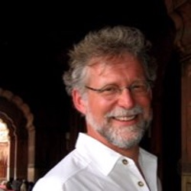
PH205: French Philosophy in Context – 1930s to the Present
Exploring the development of French philosophy from the interwar period to the present and using the city of Paris as its context, this course examines how social and political challenges influenced the paths of French philosophical reflection, moving thinkers to question the foundations of knowledge, morals, and politics, leading ultimately to what might be called a “decentered” cosmopolitanism.
Topics covered include existentialism and the dramatic events of the interwar and Second World War periods; feminist and postcolonial theories and the liberation struggles of colonial Indochina, Algeria, and the “Third World” more generally; structuralism and the ideological and practical battles of the Cold War; poststructuralism and the 1968 student and worker uprisings; and contemporary multicultural and cosmopolitan philosophies and the developments associated with globalization, postcolonial immigration, populism, and terrorism.
We take full advantage of all that Paris has to offer—countless museums, a diverse cultural life, streets marked by historical events, and an ongoing intellectual tradition in which philosophy is expected to have a direct impact on how people live and in which philosophers themselves often become cultural “stars.” Students share group apartments in the city’s neighborhoods, learning what is it to live like a Parisian.
Generally taught in block 2; next offerings in the fall of 2022 and 2023.

Slide 12
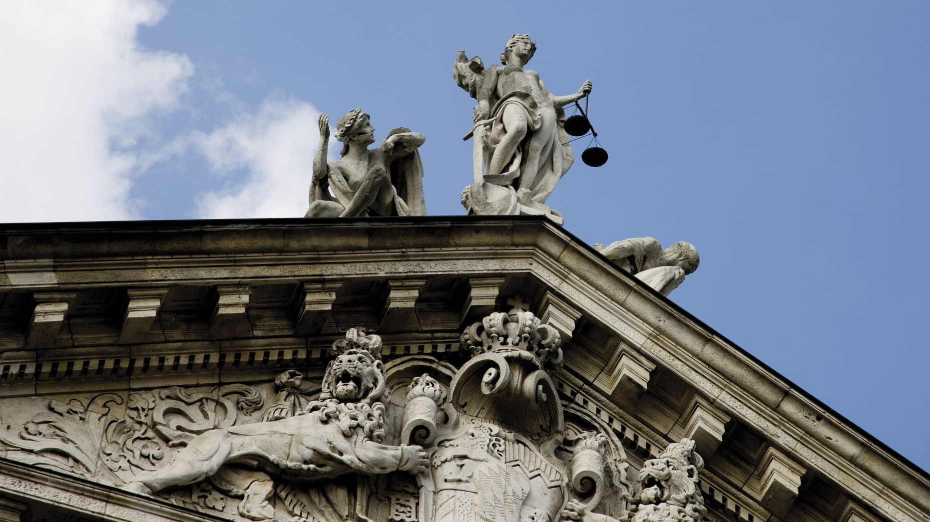
Poetry and Philosophy in Greece
Professors Jonathan Lee (Philosophy) and David Mason (English)
On the road throughout Greece

Slide 13
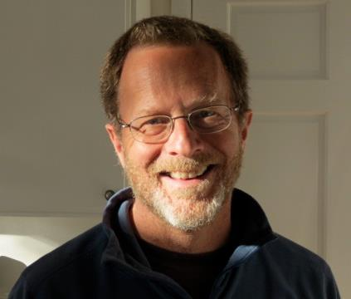
PH203:
The Art of Living - Greek Poetry and Philosophy
From the very beginnings of Greek literature, the practice of poetry and the practice of philosophy have been intertwined. Even as philosophers criticize poets and poets make fun of philosophers, the two modes of writing share a deep concern for the art of living. Homer and Hesiod—whose epic poems are the earliest surviving poetry of Greece—and the archaic lyric poets devote themselves to a careful imagining of different ways of living and offer powerful critiques of lives that fail to achieve the fullness of human being. The earliest archaic philosophers—whose work appears at roughly the same time as the flowering of lyric poetry—similarly steer their readers towards lives worth living. What these poets and philosophers share is a profound sense of wonder, wonder stirred by the beauty and terror of the natural world and by the wisdom and folly of gods and mortals.
The course, The Art of Living: Greek Poetry and Philosophy, explored what the Greeks still can teach us about the life fully lived. The course pursued this theme both through study of a series of texts—poetry and prose—from Homer to the 21st century and through living in a series of locations centrally important to the literary and philosophical history of Greece, including Athens, Crete, the Peloponnesos, and Lesbos. Greek philosophy and poetry came to life for our students in unique ways when they found themselves living with the sea, the mountains, and the light that have profoundly shaped the Greek experience for millennia.
Offered in the spring of 2008, 2010, 2013, and 2016.

Slide 14

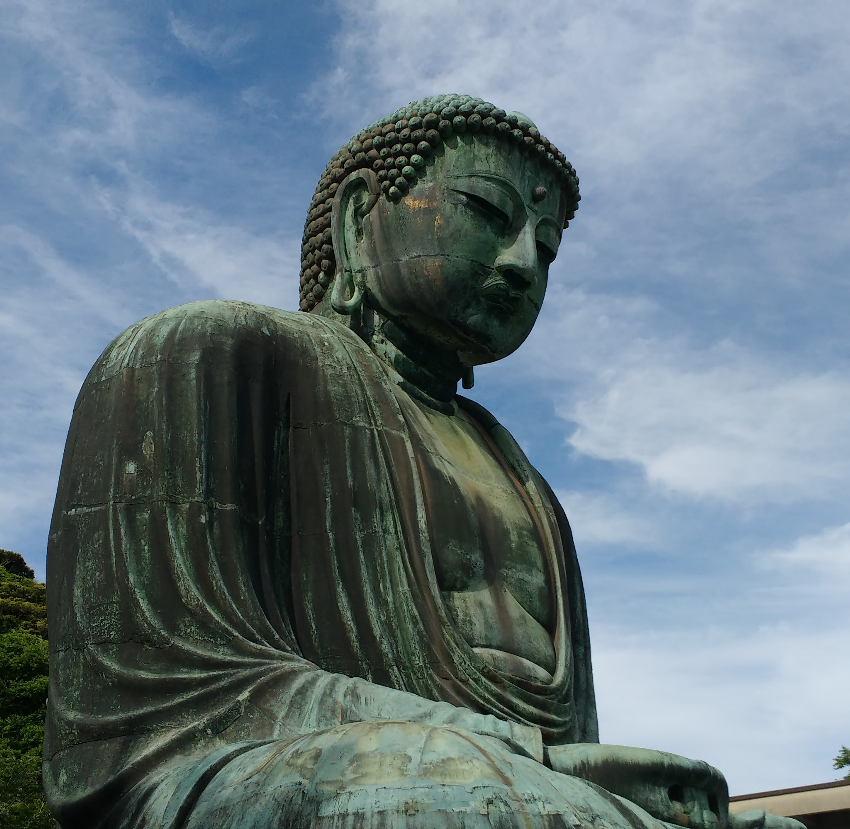
East Asian Philosophical & Spiritual Traditions in Japan
Professors Marion Hourdequin (Philosophy) and David Gardner (Religion)
Taught at International Christian University, Tokyo
Giant Buddha (Daibutsu) at Kamakura

Slide 15
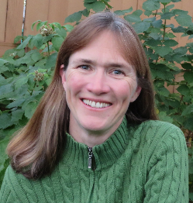
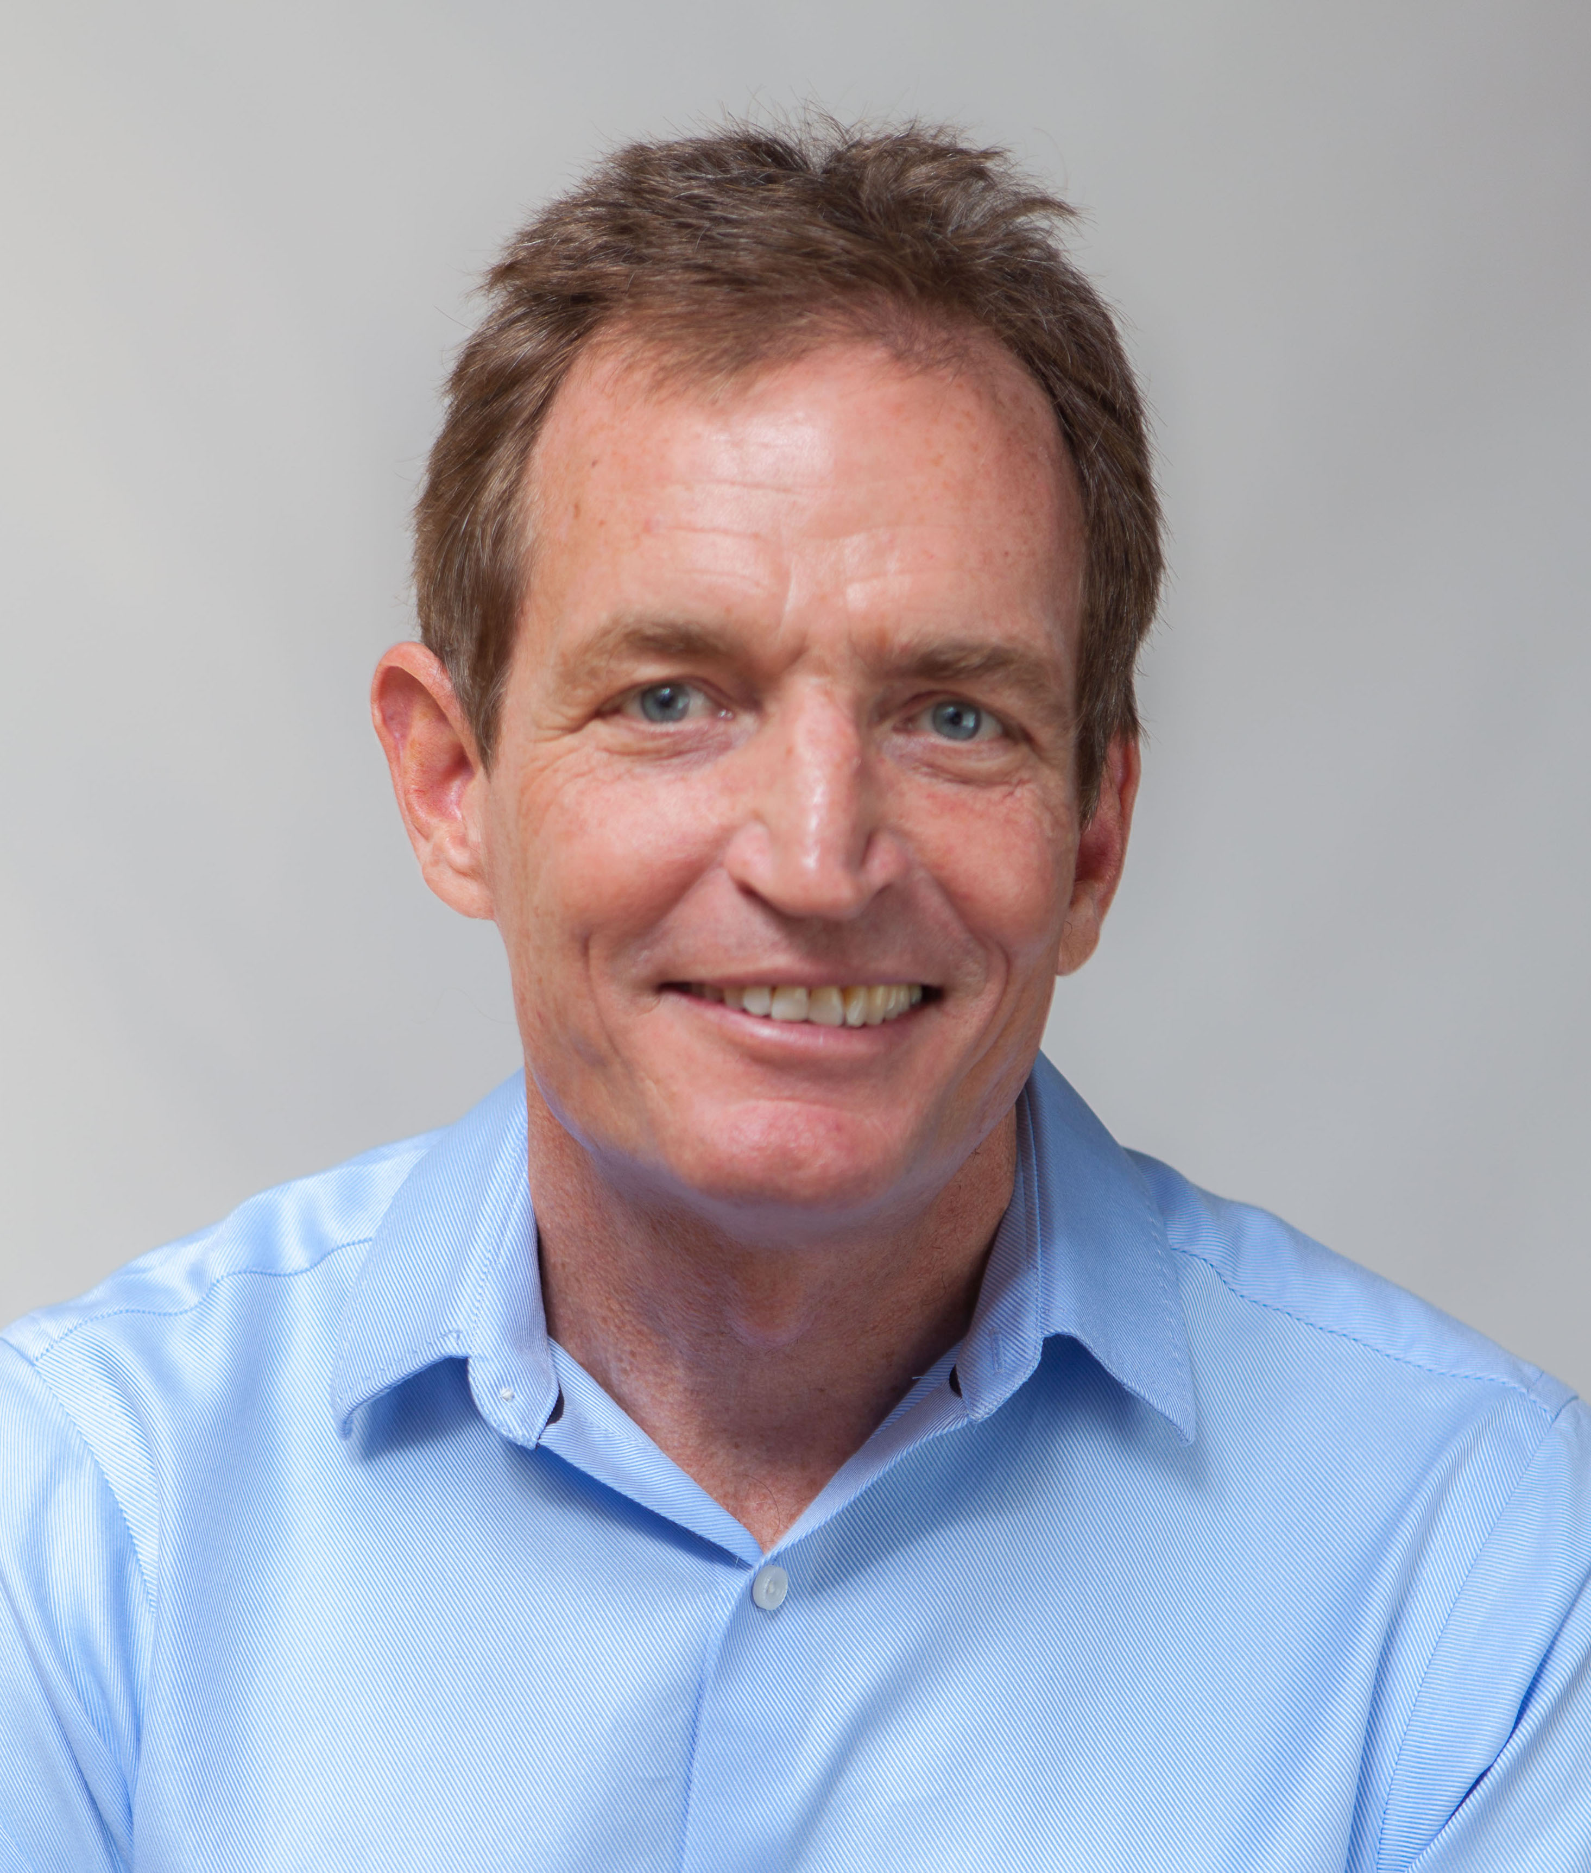
PA250: Buddha, Nature, Dao
Buddha, Nature, Dao was offered as part of CC's Semester in Japan program in 2017. The course explored key religious, philosophical, and spiritual traditions in East Asian history (Confucianism, Daoism, Shinto, and Buddhism), focusing on relations between human and non-human worlds. Drawing on both historical and contemporary texts, the course considered ways in which East Asian religious and philosophical traditions have been interpreted and adapted to inform contemporary conceptions of humans and nature.
Because the course was taught at a Japanese university -- International Christian University (ICU) -- the class included a mix of Colorado College and ICU students, providing valuable opportunities for intercultural dialogue. Field trips to Buddhist temples, the Great Buddha at Kamakura, and Shinto shrines -- as well as a Kabuki theater performance, boat trip in Tokyo Bay, and Tokyo Giants professional baseball game -- complemented the classroom learning experiences.
In an earlier edition of CC's Semester in Japan program, Professor Hourdequin taught a Nature, Food, and Agriculture course, also at ICU.

Slide 16
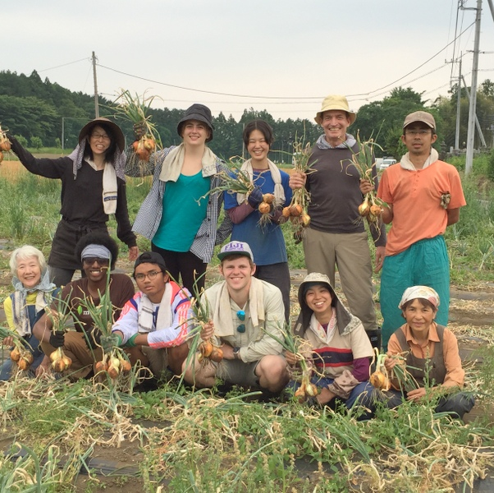
Students and faculty harvesting onions on a 2015 field trip for the nature, food, and agriculture course (part of a day trip where we collaborated with a local community farm and participated in a rice planting there).

Slide 17
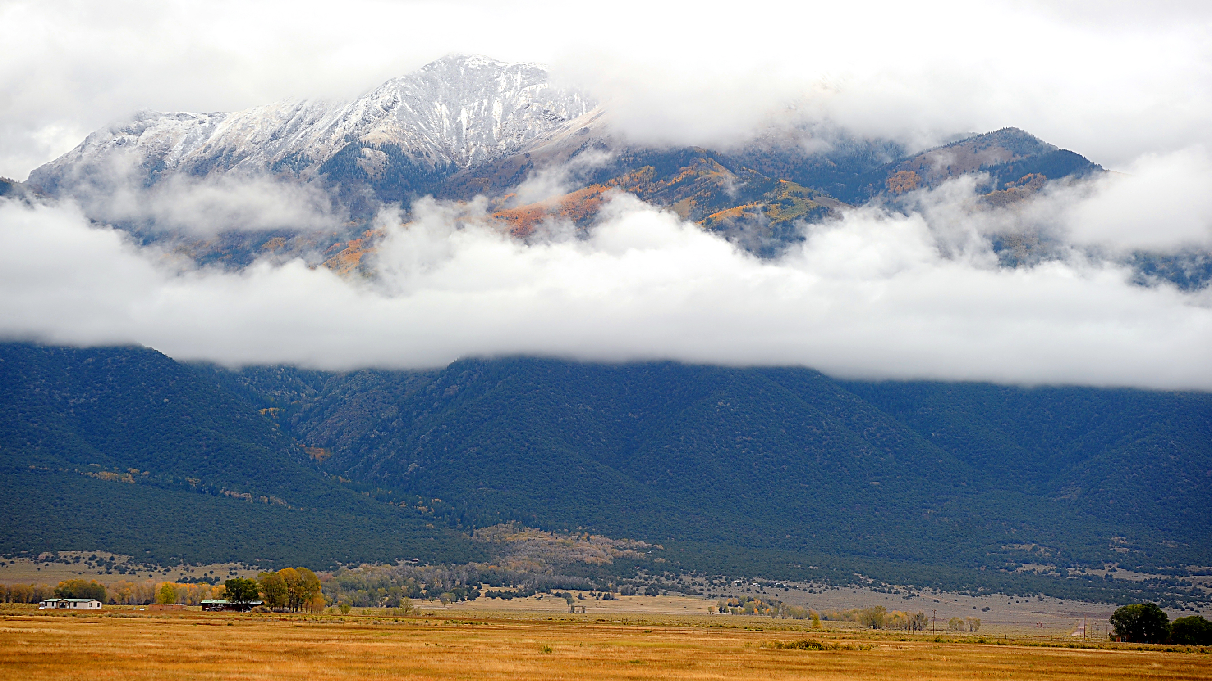
Philosophy Courses at the
Baca Grande Campus

Slide 18
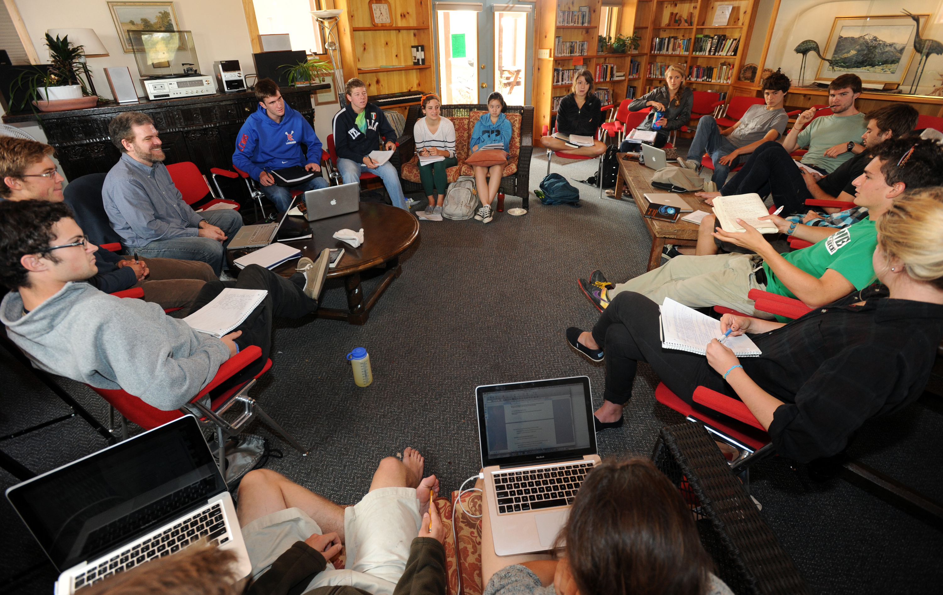
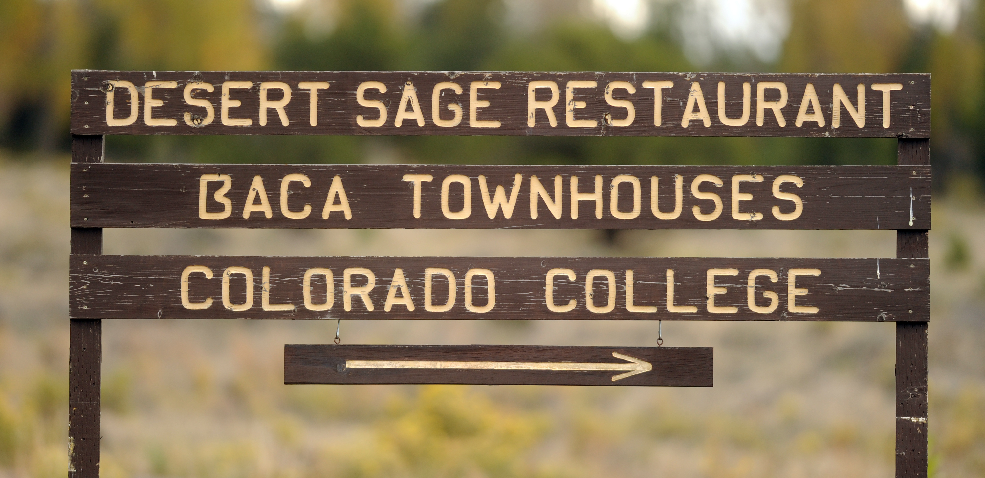
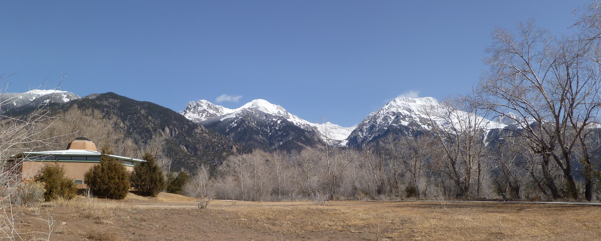
Withdrawing to the beautiful Baca campus in the San Luis Valley allows classes to reflect on ideas and challenges without the distractions of everyday modern life, while building ties of sympathy and understanding.
Next Baca offering: PH244 - Classical Social & Political Philosophy, Professor Dennis McEnnerney, block 7, 2022.

